Slide 1
1
Labor Market
Journey to Work
Wayne County, IN has slightly more workers commuting out than commuting in the region for work.
Net commuting is negative in the Wayne County, IN with a loss of 217 commuters. For every 100 employed residents, there are roughly 99 jobs in the Wayne County, IN, which suggests the region is close to serving as a job center for the regional labor market.
12,092
In-Commuters
 | 2021 Count | Proportion
Living in Wayne County, IN | 28,239 | 100.0%
Both living and employed in the region | 15,930 | 56.4%
Living in the region but employed outside | 12,309 | 43.6%
Employed in Wayne County, IN | 28,022 | 100.0%
Both employed and living in the region | 15,930 | 56.8%
Employed in the region but living outside | 12,092 | 43.2%
15,930
Same Work/Home
12,309
Out-Commuters
Data Snapshot // Wayne County, IN
Source: On The Map

Slide 2
2
Labor Market
Commuteshed & Laborshed in 2021
12,309
12,092
Data Snapshot // Wayne County, IN
Source: On The Map

Slide 3
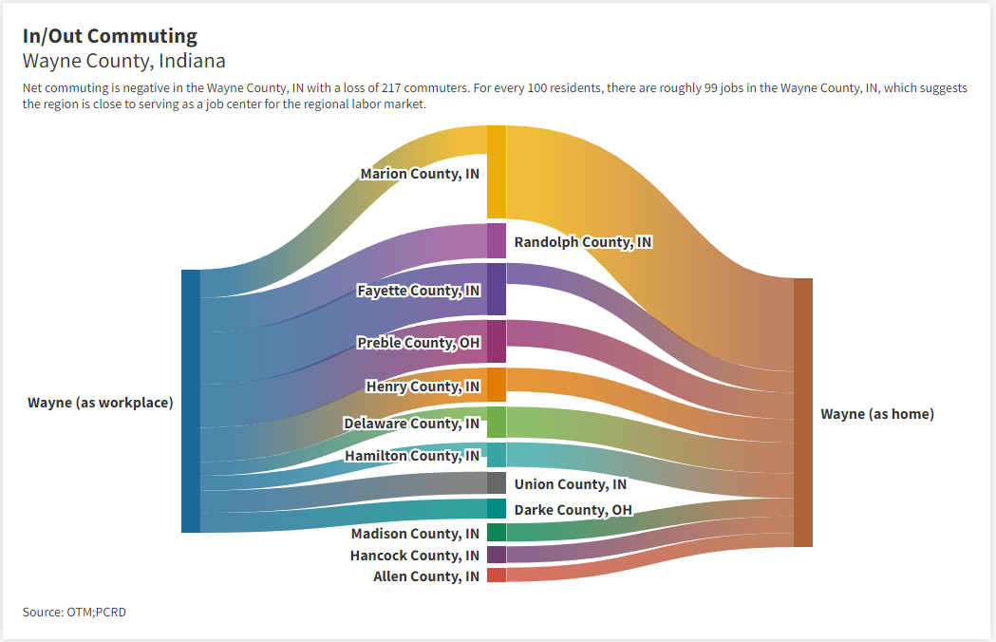
3
Labor Market
https://public.flourish.studio/visualisation/12701456/
Data Snapshot // Wayne County, IN
Source: On The Map

Slide 4
4
Labor Market
Commuteshed in 2021
Seventy-five percent of employed Wayne County residents commute to Wayne, Marion, Delaware, Henry and Hamilton counties in Indiana and Preble County, Ohio. Increasing the commuter shed threshold to 80 percent results in the inclusion of Hancock, Madison, and Fayette counties in Indiana. At the 85 percent threshold, Randolph, Allen, Hendricks, and Johnson counties in Indiana are included.
Collectively, these 13 counties represent roughly 85 percent of the commuteshed for Wayne County, IN.
A region’s commuteshed is the geographic area to which its resident work force travels to work.
 | Commuters | Proportion
Wayne County, IN | 15,930 | 56.4%
Marion County, IN | 2,416 | 8.6%
Delaware County, IN | 796 | 2.8%
Preble County, OH | 683 | 2.4%
Hamilton County, IN | 637 | 2.3%
Data Snapshot // Wayne County, IN
Source: On The Map

Slide 5
5
Labor Market
Laborshed in 2021
Seventy-five percent of the region’s workers live in Wayne, Fayette, Randolph, Marion, and Henry counties in Indiana and Preble County in Ohio. Union and Hamilton counties in Indiana and Drake County, Ohio are included in the labor shed when the threshold is extended to 80 percent. Delaware, Madison, Allen, Franklin, and Rush counties of Indiana and Montgomery County in Ohio are part of the 85 percent labor shed.
Combined, these 15 counties represent 85 percent of the laborshed for Wayne County, IN.
A region’s laborshed is the geographic area from which it draws employees.
 | Commuters | Proportion
Wayne County, IN | 15,930 | 56.8%
Fayette County, IN | 1,346 | 4.8%
Preble County, OH | 1,118 | 4.0%
Randolph County, IN | 890 | 3.2%
Henry County, IN | 883 | 3.2%
Data Snapshot // Wayne County, IN
Source: On The Map

Slide 6
6
Labor Market
Employed Workers in Wayne County in 2021
Wayne County had 28,022 labor force employed in the county, which included 12,092 labor force commuting from outside of the county to work in Wayne County. Of the total labor force, 22% (6,130 workers) earned $1,250 per month; 36% (10,002 workers) earned $1,251 to $3,333 per month; and 42% (11,890 workers) earned more than $3,333 per month.
Nearly half of the employed are in 30-54 years age-range, mix of prime-working and matured workers. 61% worked in services industries.
Data Snapshot // Wayne County
Source: On The Map

Slide 7
7
Labor Market
Employed Residents in Wayne County in 2021
Wayne County had 28,239 employed residents, which include 12,309 residents who commuted out of the county for work purposes. 22% (6,131 resident workers) earned $1,250 per month; 36% (10,096 workers) earned $1,251 to $3,333 per month; and 42% (12,012 workers) earned more than $3,333 per month.
Half of the employed residents were in 30-54 years age-range, mix of prime-working and matured workers. 57% worked in services industries.
Data Snapshot // Wayne County
Source: On The Map
Notes:
Excel File: OTM_Fulton.xlsx

Slide 8
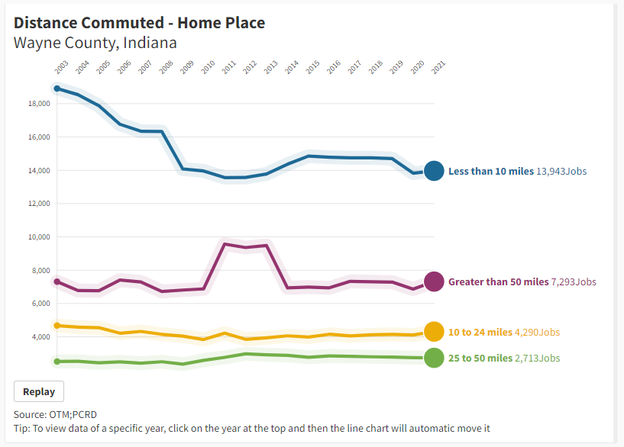
8
Labor Market
https://public.flourish.studio/visualisation/12701693/
Data Snapshot // Wayne County, IN
Source: On The Map

Slide 9
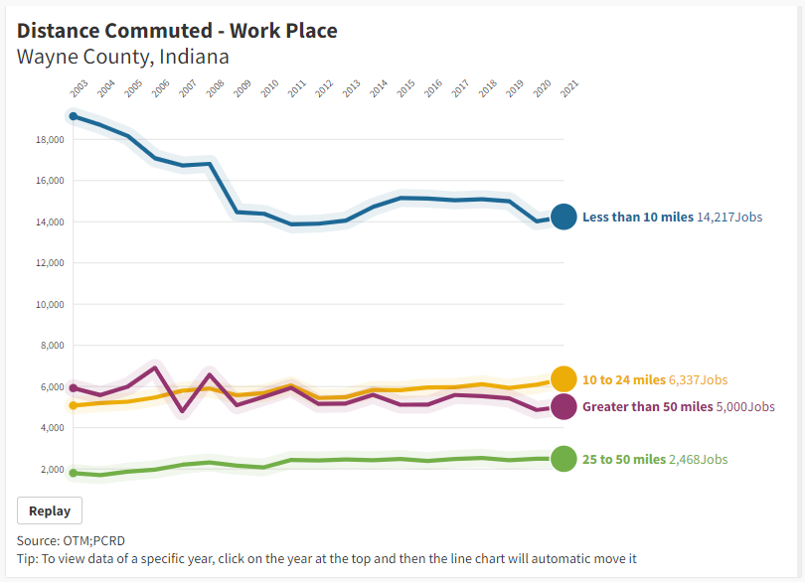
9
Labor Market
https://public.flourish.studio/visualisation/12701706/
Data Snapshot // Wayne County, IN
Source: On The Map

Slide 10
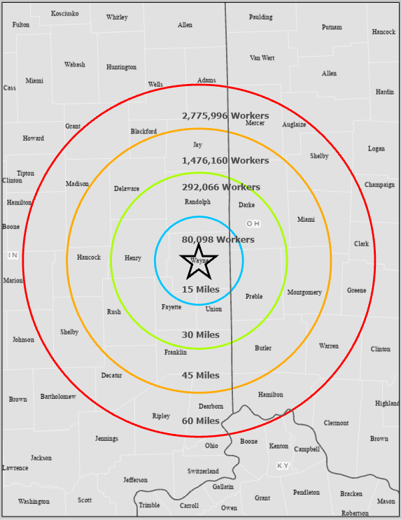
10
Labor Market
Distance (miles) | Workers 2021 | High school | Some college or Associate | Bachelor’s or higher
15 | 80,098 | 27.1% | 25.4% | 15.2%
30 | 292,066 | 25.1% | 24.8% | 17.4%
45 | 1,476,160 | 22.9% | 24.7% | 20.5%
60 | 2,775,996 | 22.5% | 24.4% | 20.9%
The resident employed labor force varies between 80,000 individuals at 15-mile radius to almost 2.77 million individuals at the 60-mile radius region.
Source: On The Map
Data Snapshot // Wayne County, IN

Slide 11
11
Labor Market
The distance-based rings are drawn at 15, 30, 45, and 60-miles from the centroid of the Wayne County in Indiana.
The number of workers are employed residents or the working labor force living within the circular labor-market area.
For example, at 60-mile radius approximately 2.77 million working labor force are available. Nearly 23% of that labor force have high school or equivalent education; 24.4% have some college or associates degree; and 20.9% have bachelor’s or higher education.
The regional data are built by aggregating the census block level data, which is the most granular geography. Regional estimates are relatively more accurate.
Source: On The Map
Data Snapshot // Wayne County, IN

Slide 12
This report was prepared by the Purdue Center for Regional Development.
Appendix
12
Report Contributors
Authors/Editors
Data Analysis
Ben St. Germain
Report Design
Tyler Wright
Ben St. Germain
Indraneel Kumar, Ph.D.
Data Snapshot // Wayne County

